Slide 1
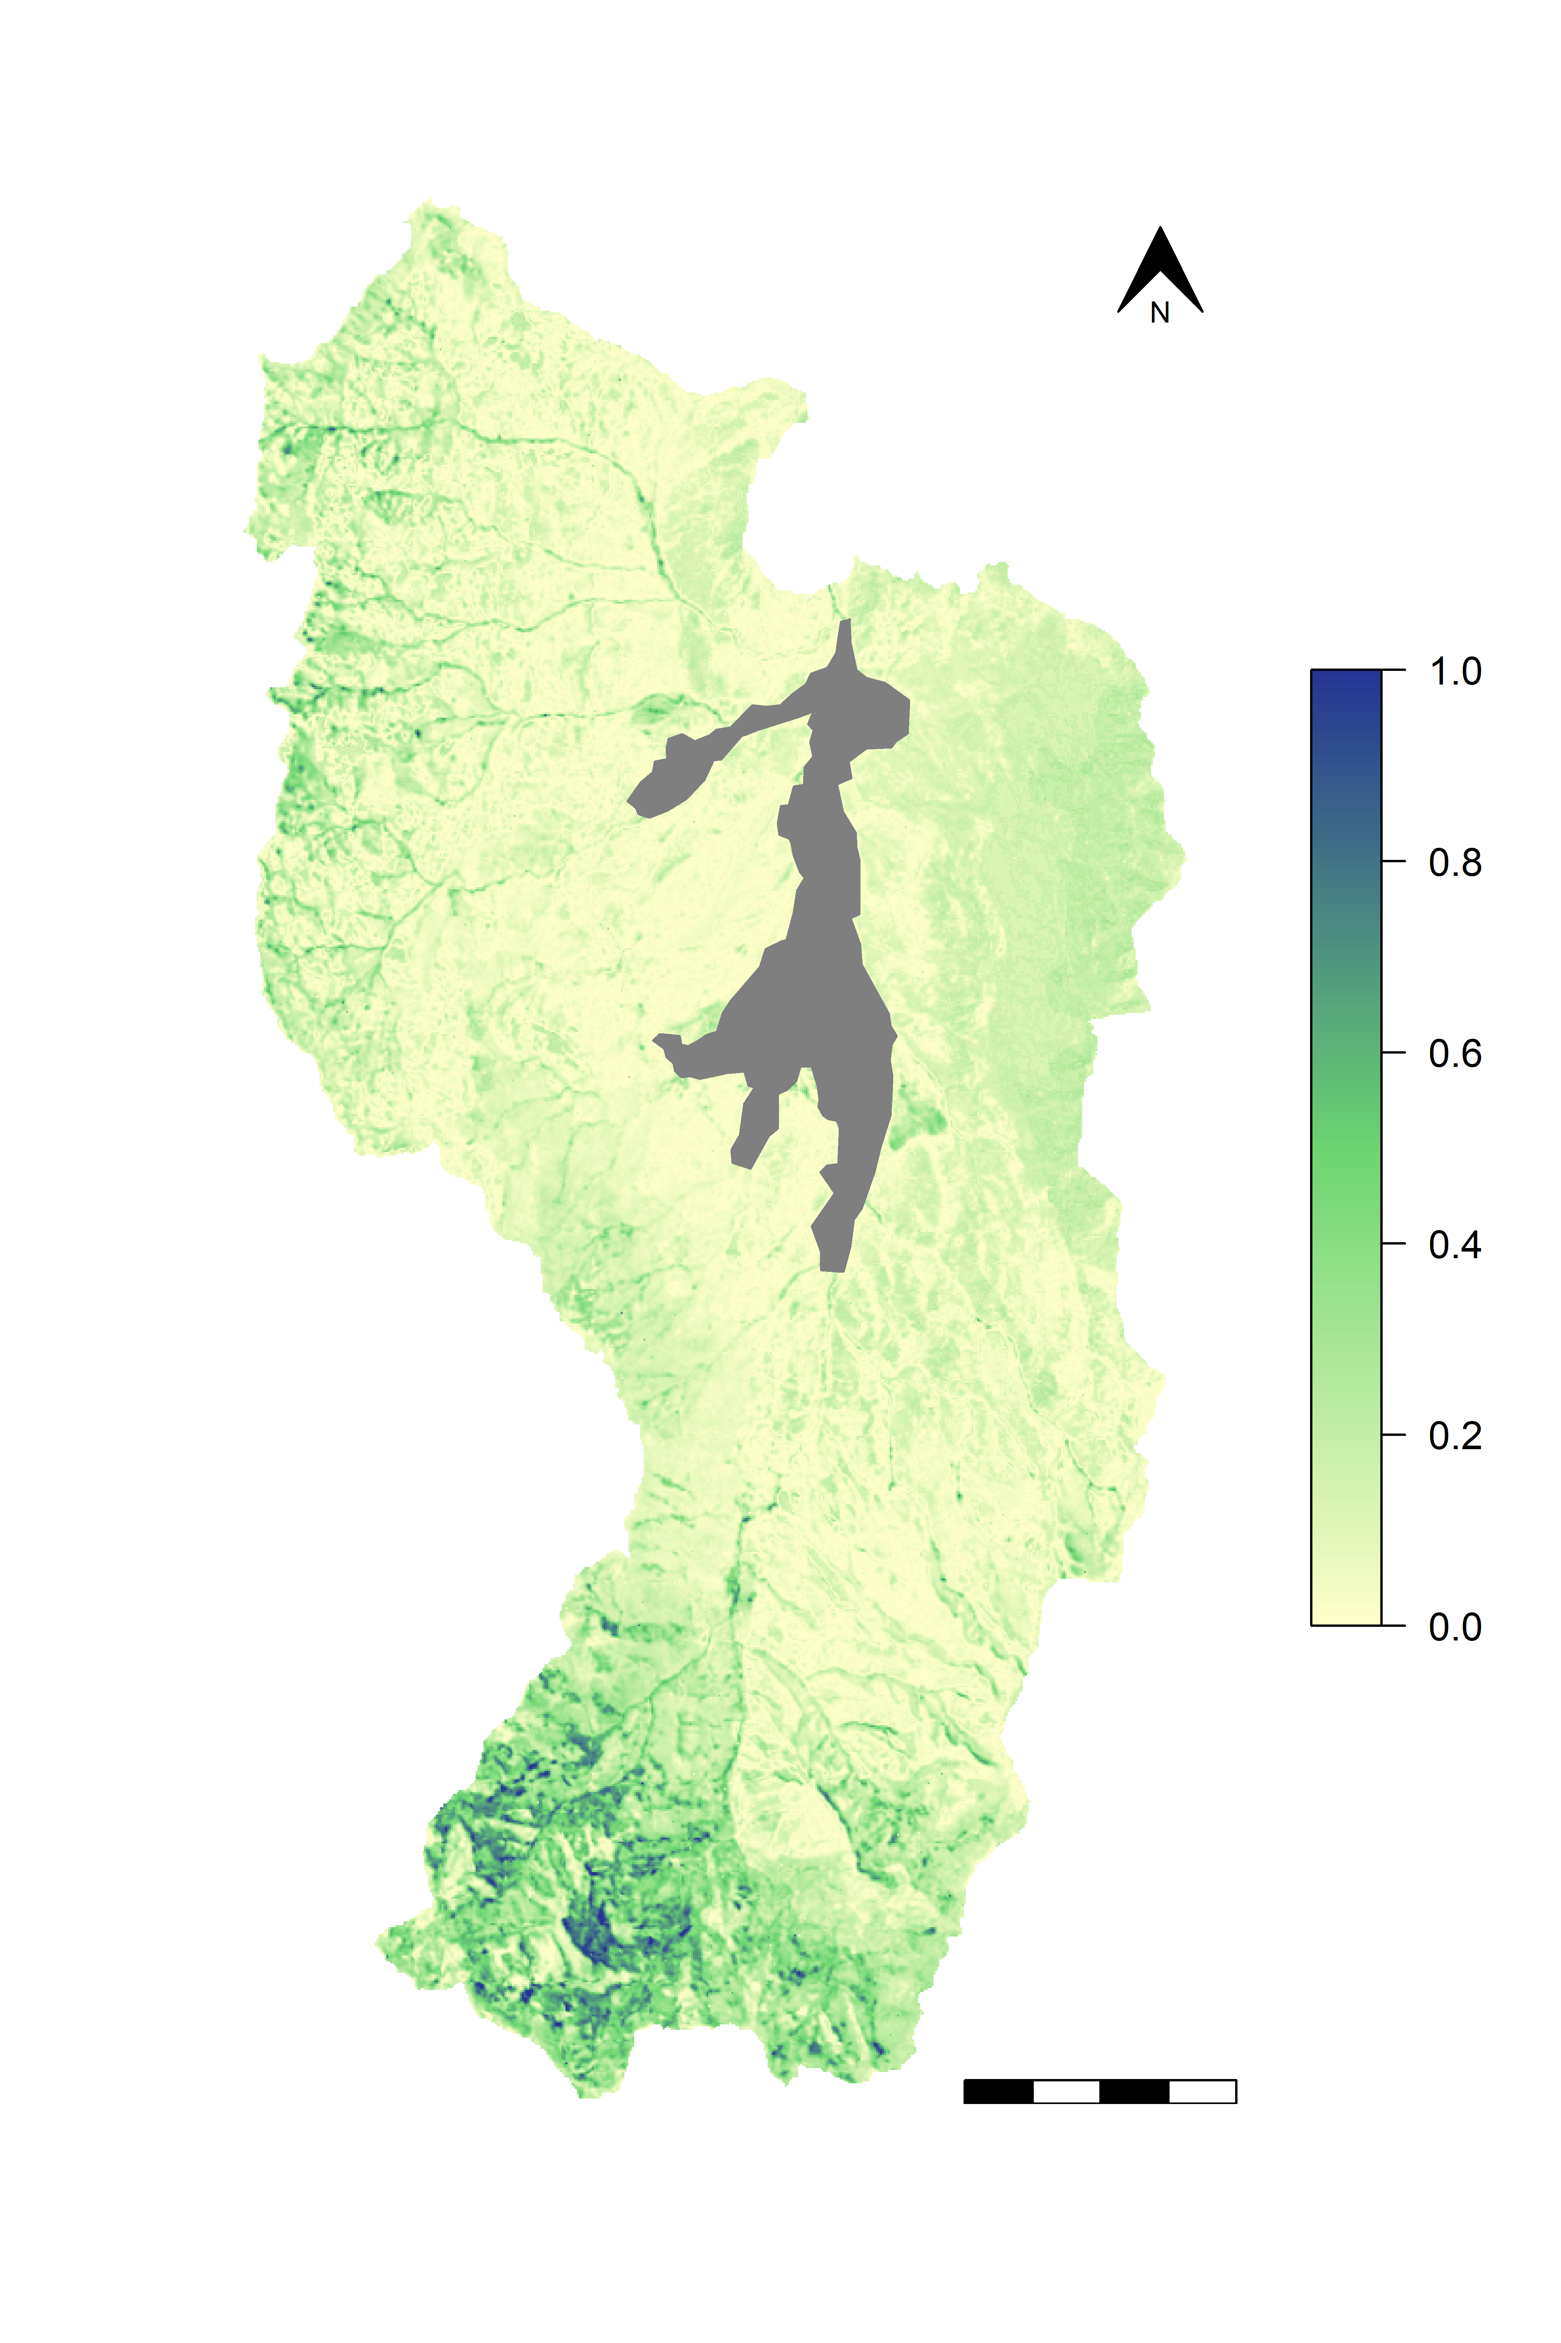
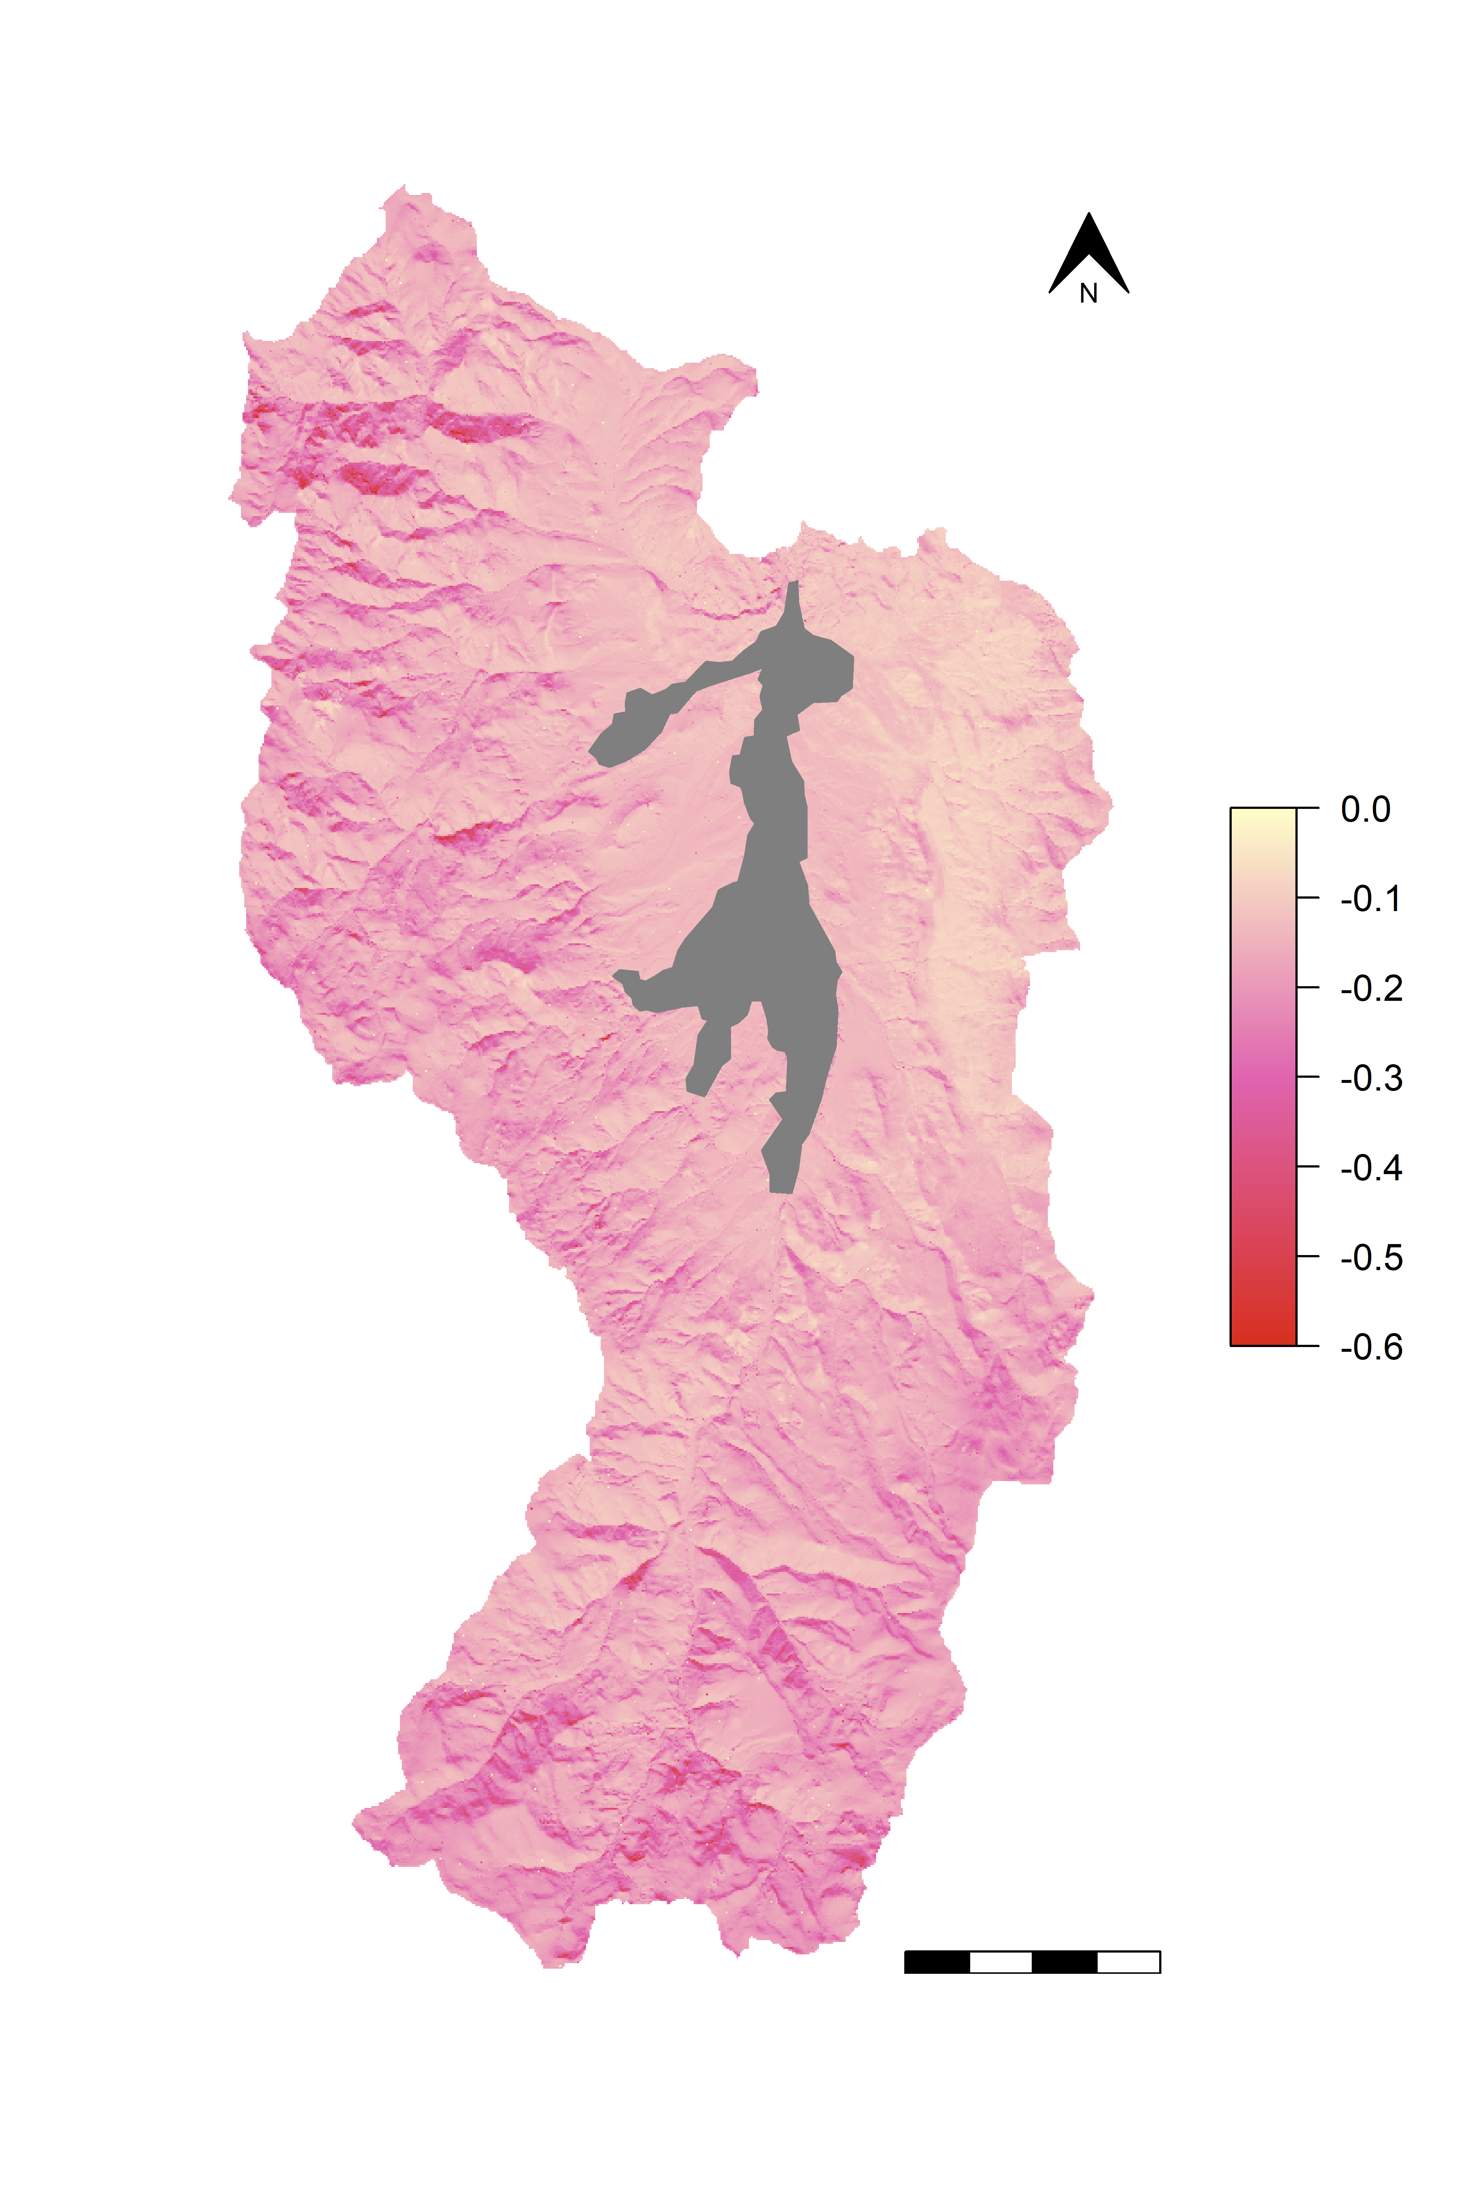
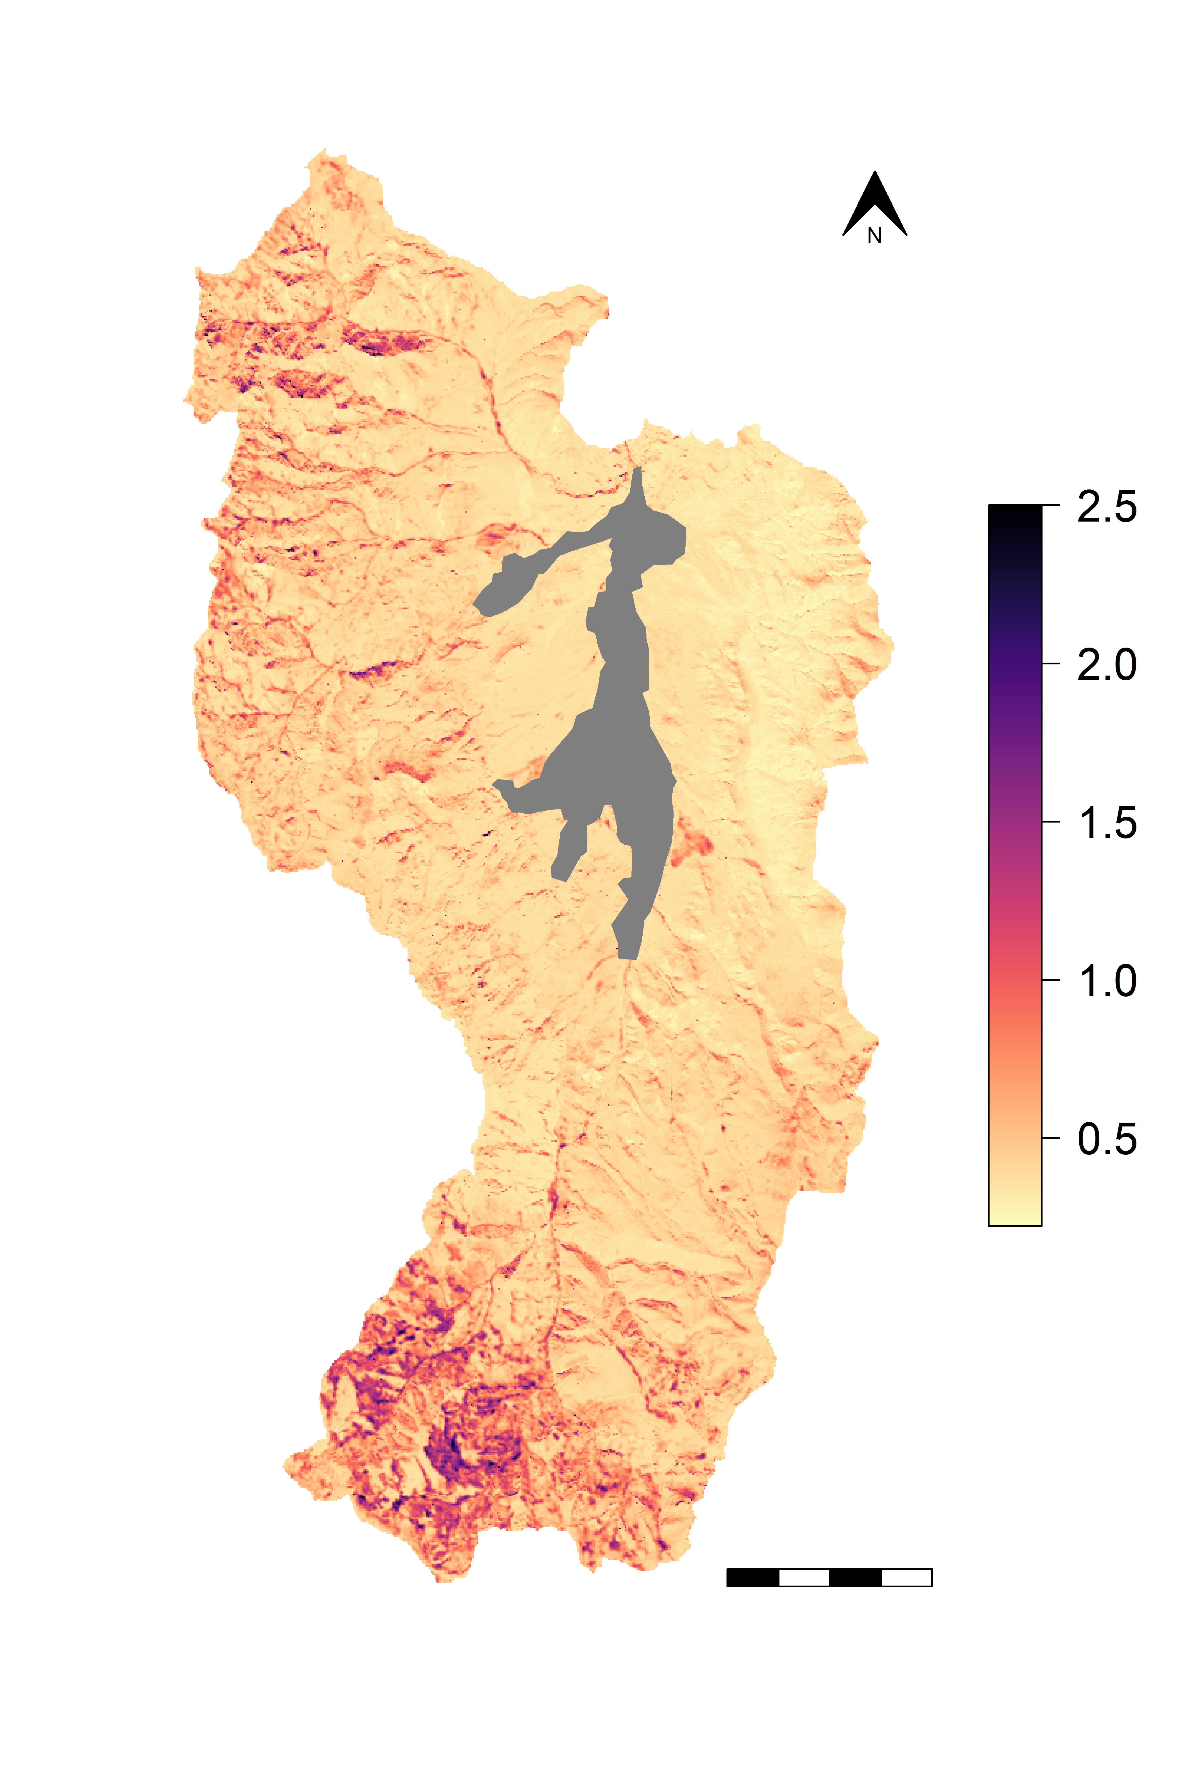
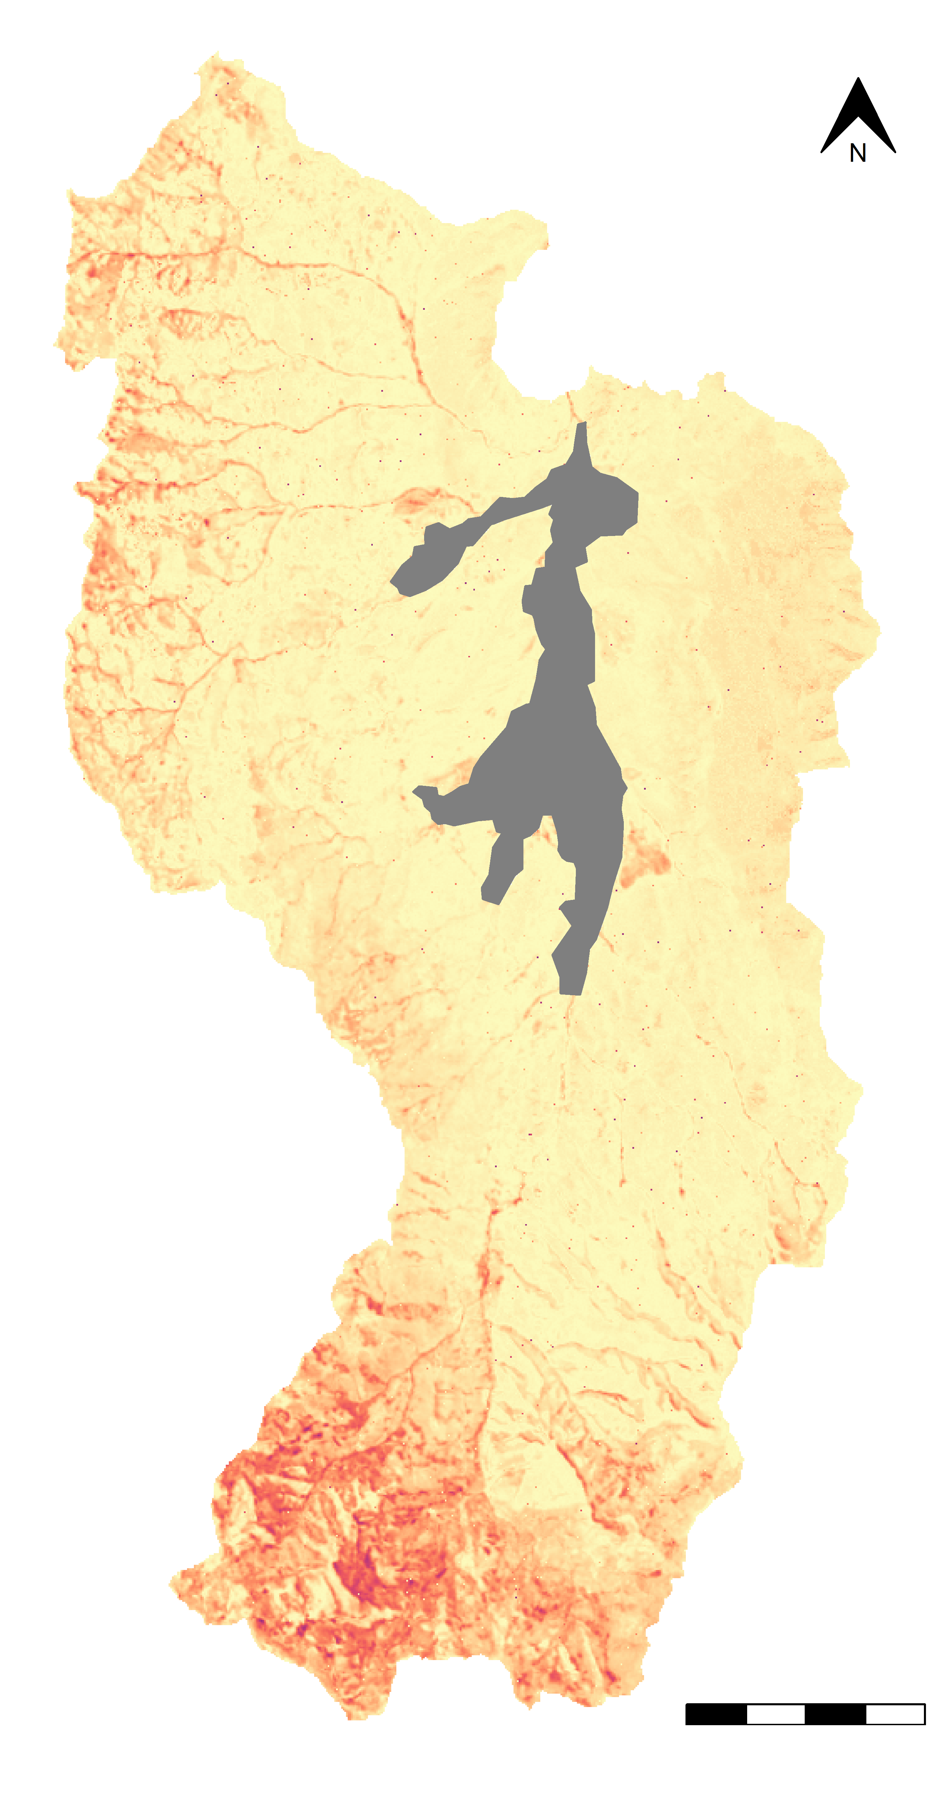
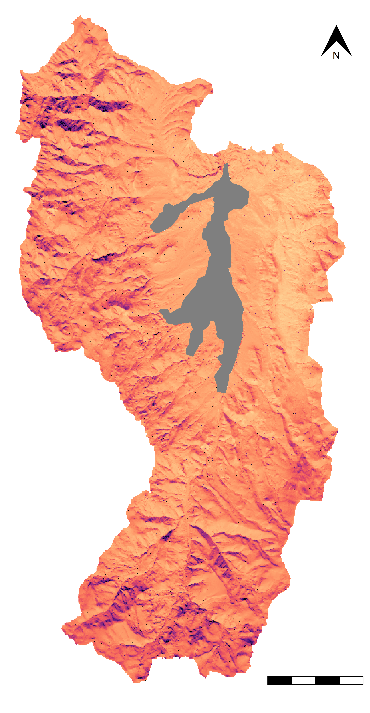
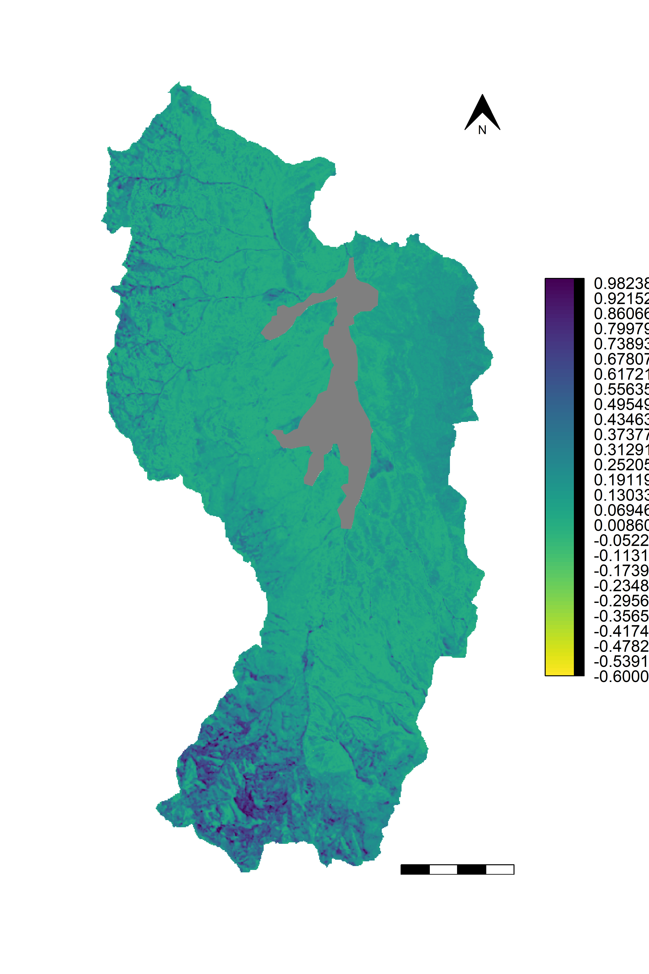
A
Gross Primary Productivity +10%
Soil Temperature +1 ̊C
MIMICS Projected Change in 0-30 cm SOC Stocks (kgC m⁻²)
1.0
0.8
0.6
0.4
+10% GPP
Gain
0.2
0
-0.2
+1 ̊C Soil Temp. Loss
-0.4
-0.6
B
MIMICS Ensemble Projected Change Standard Deviation (kgC m⁻²)
0.5
0.4
0.3
0.2
0.1
Agricultural Lands
4 km

Slide 2
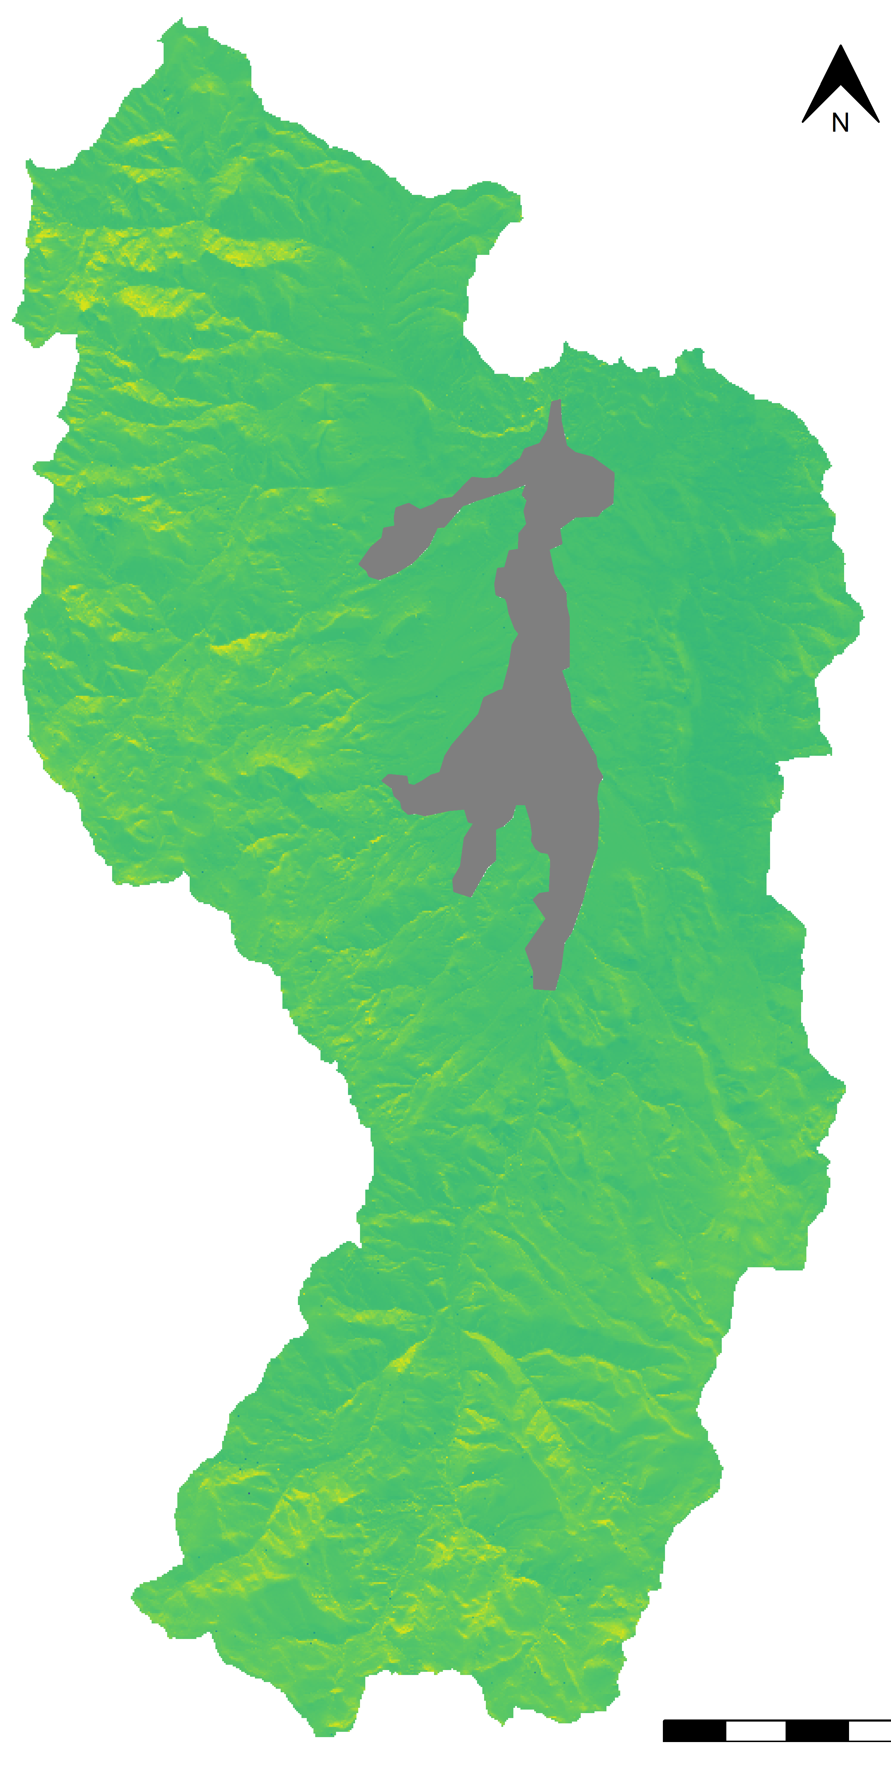
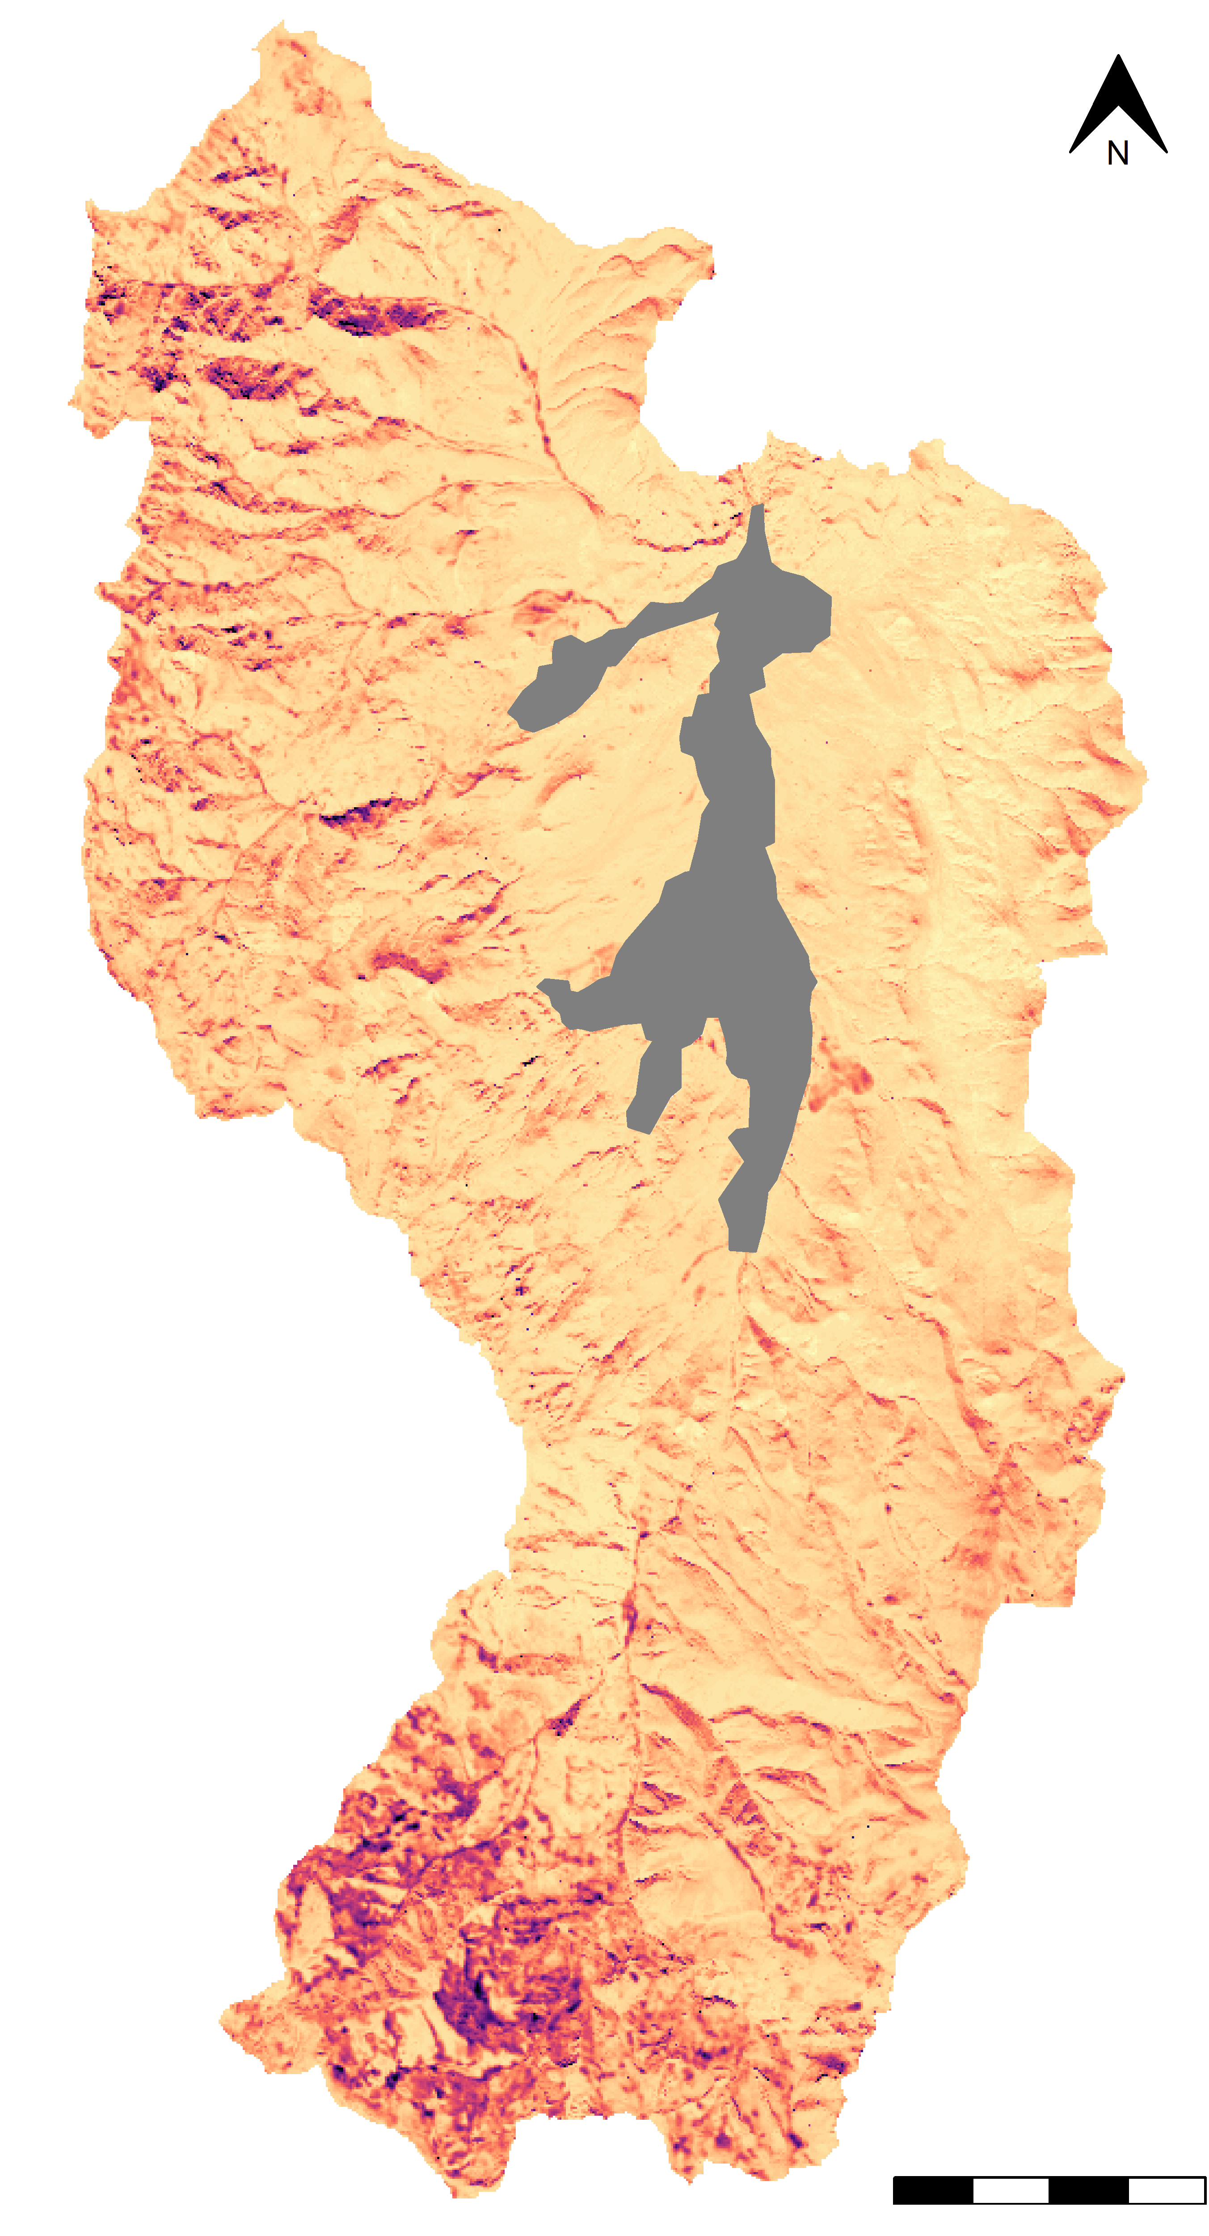
Gross Primary Productivity +10%
Soil Temperature +1 ̊C
MIMICS Projected Change in 0-30 cm SOC Stocks (kgC m⁻²)
0.9
0.6
0.3
0
-0.3
-0.6
MIMICS Ensemble Projected Change Standard Deviation (kgC m⁻²)
2.5
2.0
1.5
1.0
0.5
Agricultural Lands
4 km

